Slide 1
Robot
Operating
System

Slide 2
Table of Contents
1
3
2
4
What is ROS?
TurtleSim, RQT
Node, Topics, Service, Action
Challenges

Slide 3
What is ROS?

Slide 4
Node, Topics, Service, Action
Node
Topic
Service
Messages
Piece of code responsible for executing a specific task
Communication medium between nodes
Pontual Communication between nodes
Data structure to communicate between nodes

Slide 5
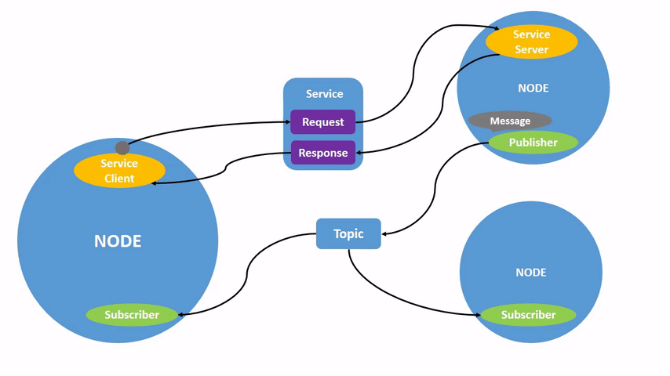
Node & Package

Slide 6
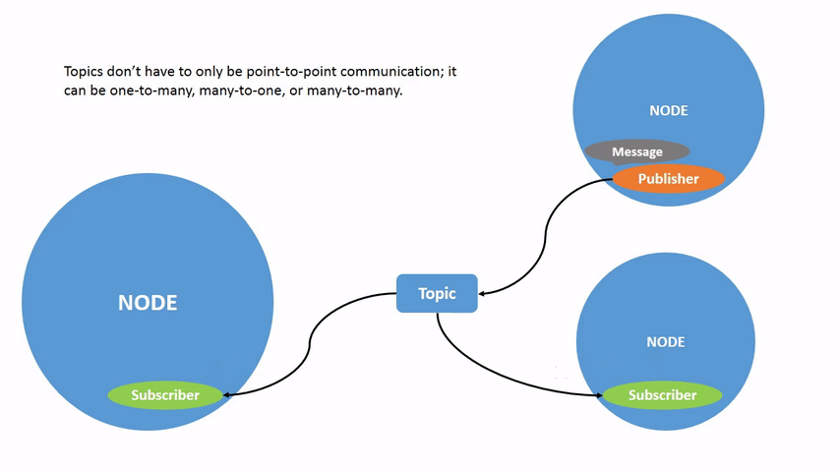
Topic

Slide 7
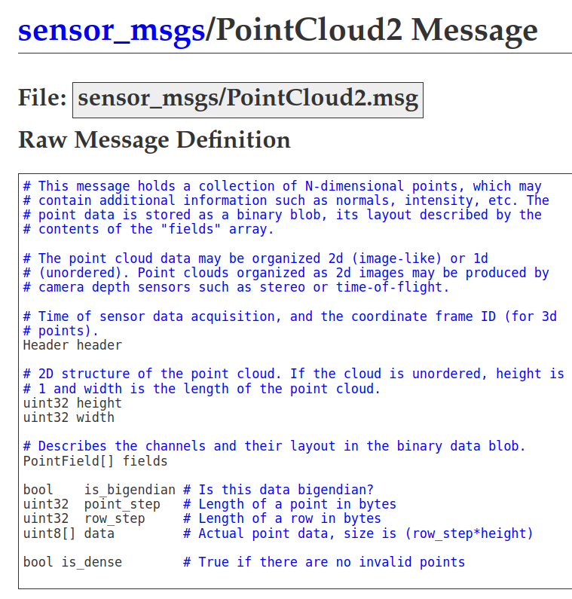
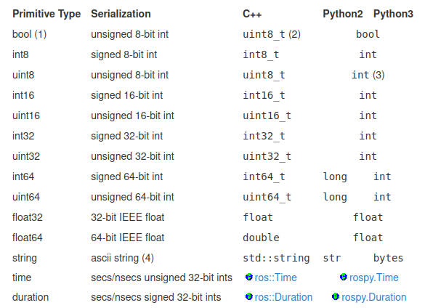
Messages

Slide 8
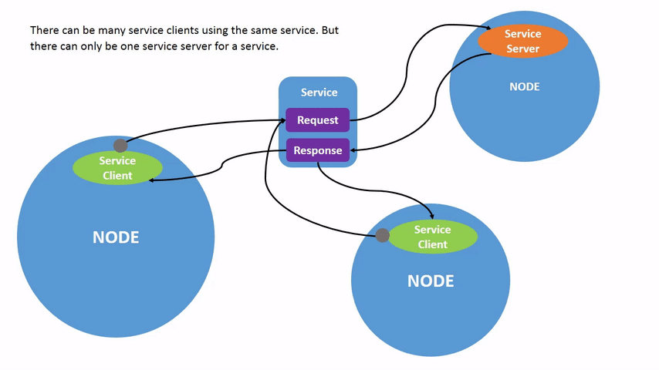
Service

Slide 9
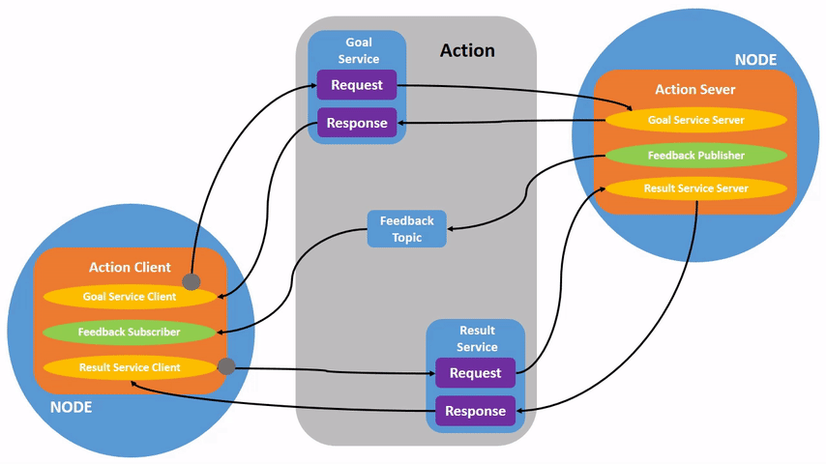
Action

Slide 10
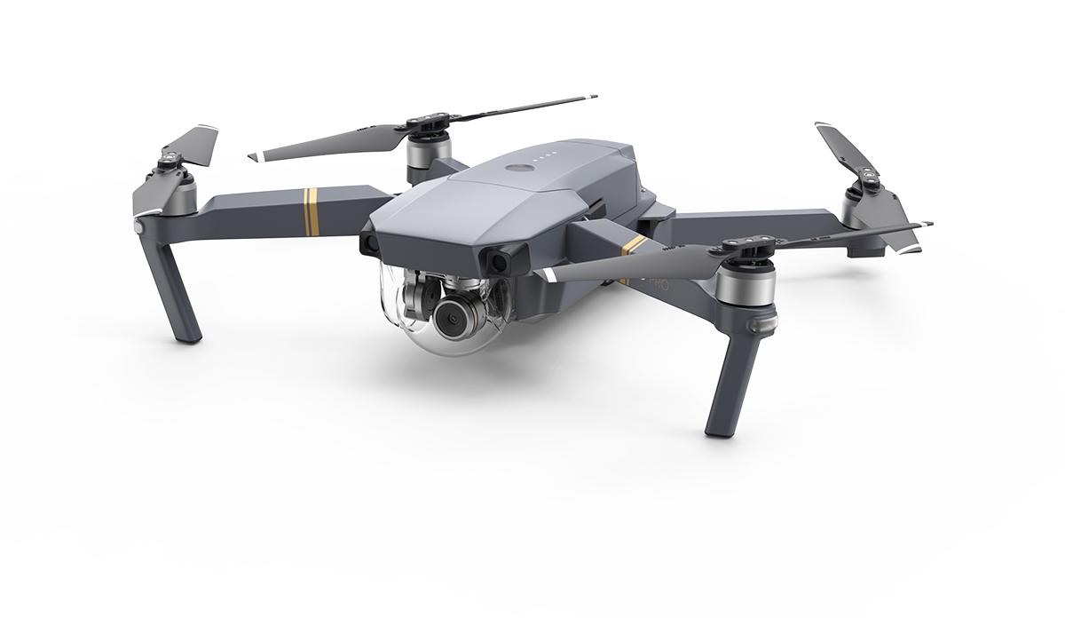
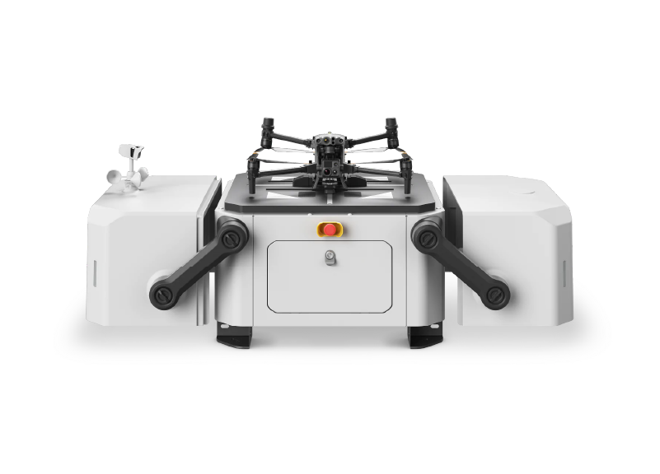
Real Scenario Application
State
height
State
Occupied

Slide 11
Commands
Source ROS2:
$ source /opt/ros/humble/setup.bash
Run a node:
$ ros2 run <package_name> <executable_name>
Check node list:
$ ros2 node list
Check node info:
$ ros2 node info <node_name>

Slide 12
Commands
Check topic list:
$ ros2 topic list
Subscribe topic:
$ ros2 topic echo <topic_name>
Publish on topic:
$ ros2 topic pub <topic_name> <msg_type> '<args>'
Check node info:
$ ros2 topic info <topic_name>

Slide 13
Commands
Check service list:
$ ros2 service list
Call service:
$ ros2 service call <service_name> <service_type> <arguments>
Service type info:
$ ros2 service type <service_name>

Slide 14
Turtlesim
To use turtlesim:
Open two terminals;
Source ROS2 in both of them using:
$ source /opt/ros/humble/setup.bash
Run the turtlesim node in one terminal:
$ ros2 run turtlesim turtlesim_node
And run the teleop node in the other terminal:
$ ros2 run turtlesim turtle_teleop_key
Now play with the previous commands to see the nodes, topics and services running!

Slide 15
How do I
make a node?

Slide 16
Install Colcon and create workspace
Install colcon:
$ sudo apt install python3-colcon-common-extensions
Create workspace:
$ mkdir -p ~/workspace/src
Build ROS2 workspace:
$ cd workspace $ colcon build
Source ROS2 workspace:
$ source install/setup.bash

Slide 17
Create Package
Create package:
$ cd src
$ ros2 pkg create --build-type ament_cmake --license Apache-2.0 package
workspace/
│
├── build/
├── install/
├── log/
└── src/
└── package/
│
├── CMakeList.txt
├── package.xml
├── LICENSE
├── include/
└── src/

Slide 18
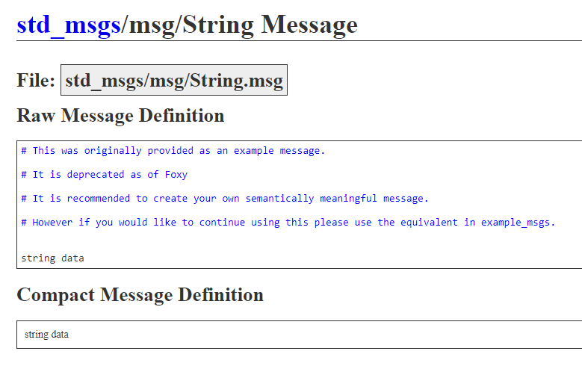
Publisher
NODE
String
TOPIC

Slide 19
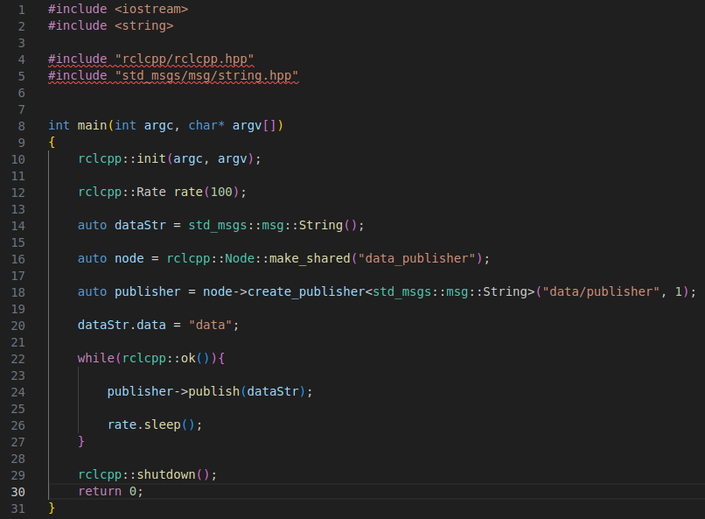
Publisher / C++
Include ROS2 and the message you want to work with
Initializes and setup up ROS2 client
Create a message variable
Create the node variable
Create the publisher variable
Publish message on topic
Shutdown ROS2

Slide 20
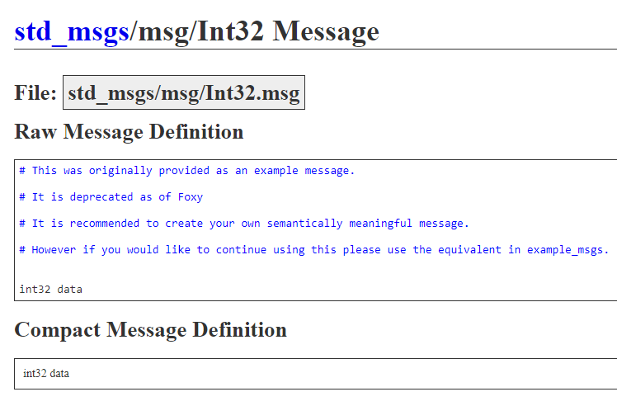
Subscriber
NODE
Int32
TOPIC

Slide 21
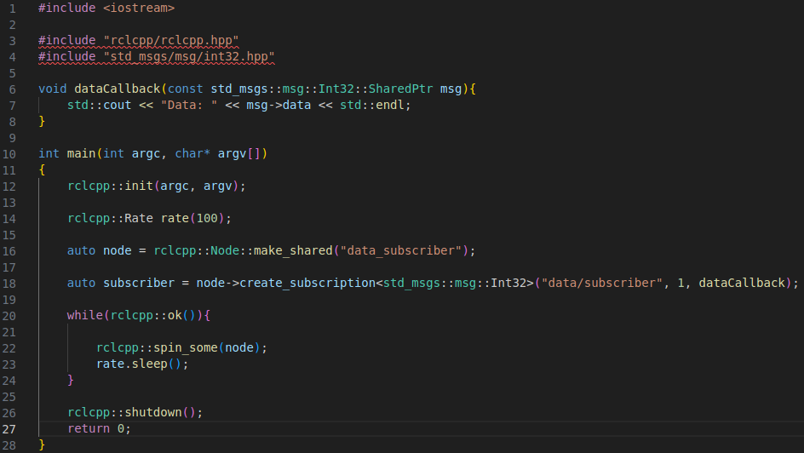
Subscriber / C++
Include ROS2 and the message you want to work with
Creates the callback function
Initializes and setup up ROS2 client
Create the node variable
Create the subscriber variable
Runs the callback function
Shutdown ROS2

Slide 22
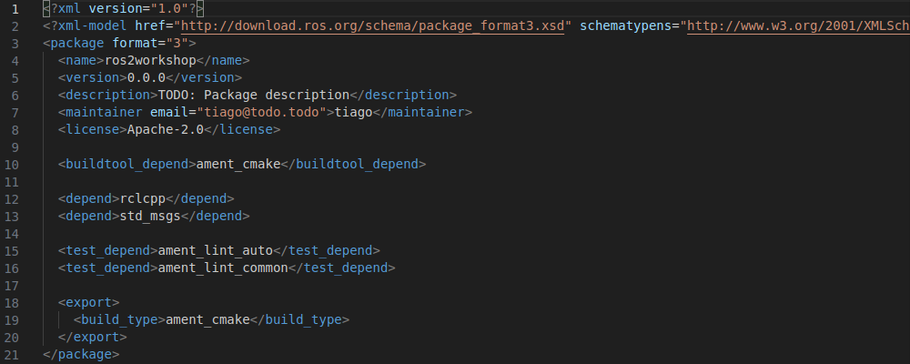
package.xml

Slide 23
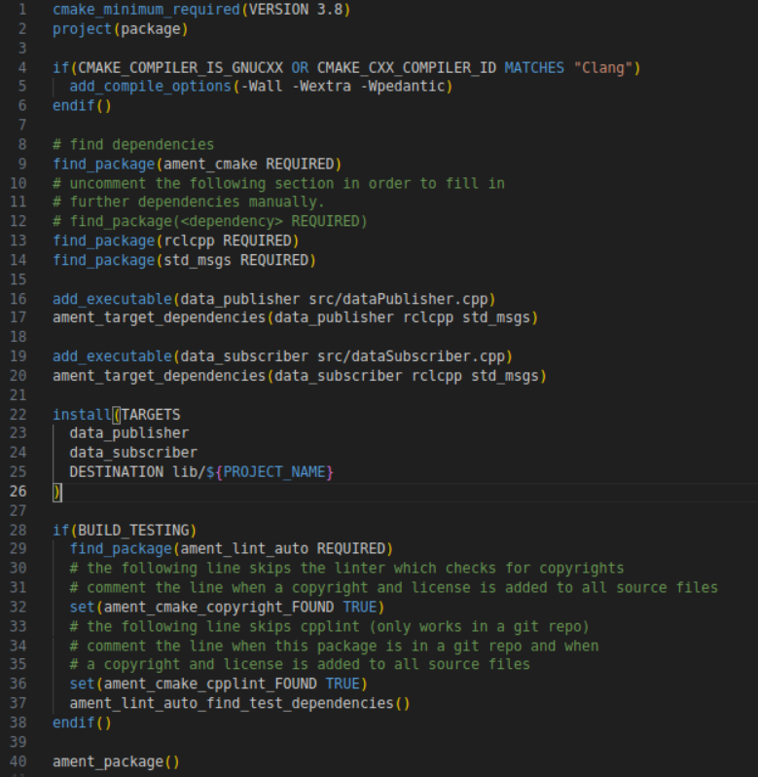
CMakeLists.txt
find_package(rclcpp REQUIRED)
find_package(std_msgs REQUIRED)
add_executable(data_publisher src/dataPublisher.cpp)
ament_target_dependencies(data_publisher rclcpp std_msgs)
add_executable(data_subscriber src/dataSubscriber.cpp)
ament_target_dependencies(data_subscriber rclcpp std_msgs)

Slide 24
Challenges

Slide 25
Activity - Publisher
publisher_PI
Complete the code in the node “publisher_PI” that publishes the Int32: “31416” in the topic “topic/pub”;
Add the executables in the CMakeList.txt file;
Compile the workspace using:
$ colcon build
in the workspace directory;
Now source the workspace in two different terminals using:
$ source install/setup.bash
Finally run the publisher and the subscriber using these commands in two different terminals:
$ ros2 run package sub_pi
$ ros2 run package pub_pi
Check if the subscriber node is printing the correct value!
Int32
topic/pub
subscriber_PI

Slide 26
2. Activity - Subscriber
topic/set
Complete the code of the “subscriber_string” node, and make it print the String data he is receiving from the “topic/subs” topic;
Add the executable to the CMakeList.txt;
Build the workspace in the workspace directory using:
$ colcon build
Source the workspace in two different terminals using:
$ source install/setup.bash
Run the nodes using these commands in the two terminals:
$ ros2 run package pub_string
$ ros2 run package sub_string
Now the node you created should be printing “You subscribed correctly”, try to run this command in a new terminal and see what happens:
$ ros2 topic pub /topic/set std_msgs/msg/String "data: new_string"
publisher_string
String
topic/subs
subcriber_string
don’t forget to source ros everytime you open a new terminal

Slide 27
3. Activity - Pub/Subs
sensor_node
Write a node that subscribes the Int32 topic “sensor_topic”;
Convert the message to a String;
Publish the string you created in the topic “printer_topic”.
To see if everything is working just run your node and “printer_node” and “sensor_node”.
YOUR
NODE
Int32
String
sensor_topic
printer_topic
printer_node

